Slide 1
Paks II and public participation
Márton Fabók
2nd Conference Cooperation Danube Region Nuclear-free
PUBLIC PARTICIPATION IN NUCLEAR PROJECTS:
Opportunities and challenges
St Pölten, 22 September 2017

Slide 3
Contents
Paks II key facts
Paks II and the Hungarian public
Freedom of Information battles
Public participation in the permitting process

Slide 4
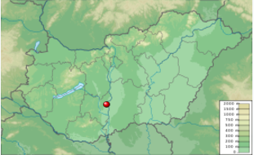
The Paks site
Four VVER-440/213 reactor blocs
4*500 MW
Constructed in 1982/1987 with a lifetime of 30+20 years
2003 serious incident at the spent fuel pool

Slide 5
Paks II overview
Key facts
VVER-1200 (AES-2006) reactors, 1180 MW each
Intergovernmental agreement (IGA) between Russian Federation and Hungary (14 January 2014)
€12.5bn turnkey contract, including €10bn intergovernmental loan
Financing IGA (March 2014)
Implementation agreements with Rosatom (Dec 2014)
Engineering, procurement and construction (EPC)
Operation and maintenance (O&M)
Fuel supply and spent fuel
MVM Paks II Ltd. project company
Government commissioner Attila Aszódi, later Minister w/o portfolio János Süli

Slide 6
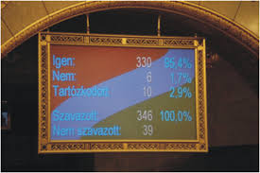
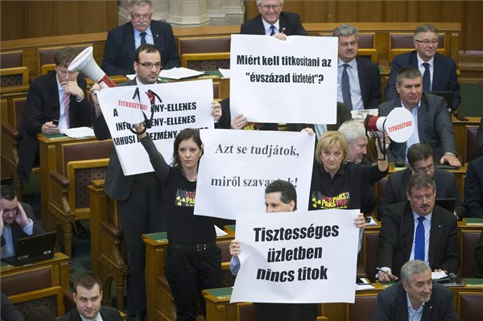
Paks II in the parliament
March 2009: Preliminary approval of all major parties for a “preliminary, in principle approval […] to start preparations for extending the blocks on the Paks nuclear site“
Single sentence with a short justification
Practically no parliamentary debate
Currently no parliamentary debate

Slide 7
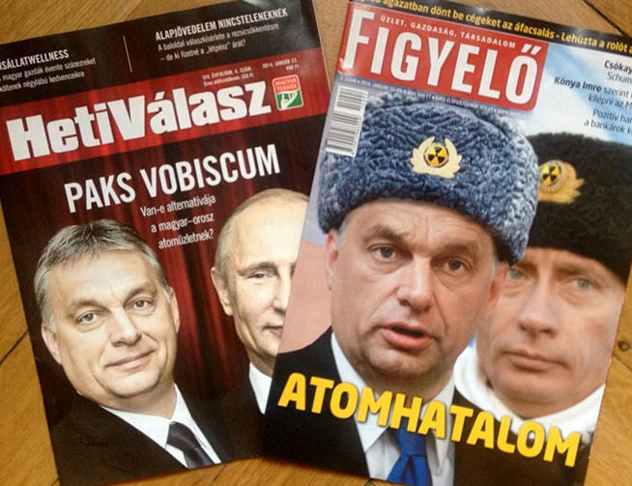
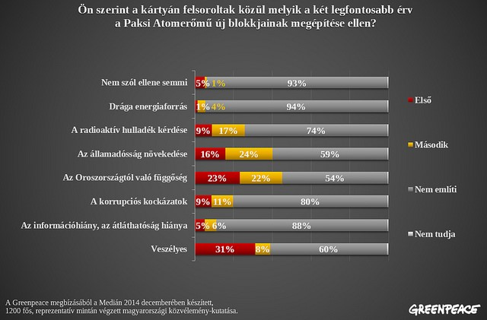
Public opinion and paks II
Previously nuclear energy was seen by the public as a marginal and technical issue
Putin-Orbán pact lead to the politicisation of nuclear power
Concerns more and more concentrate on the waste of money, dependence from Russia, and corruption than nuclear risks

Slide 8
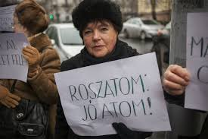
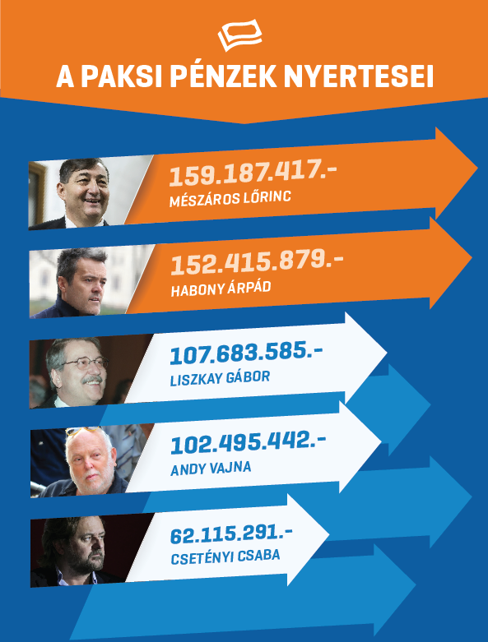
Government communication
Sponsored advertisements, especially in pro-government media
Public information campaigns locally and nationally (Nuclear Energy Museum, festival truck)

Slide 9
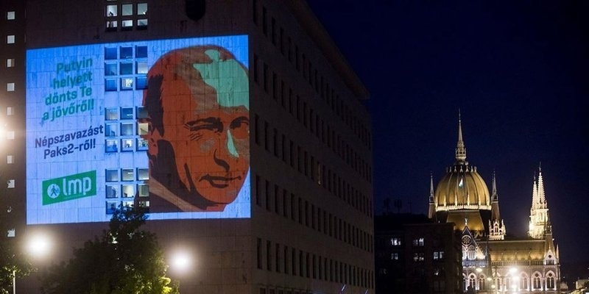
Unsuccessful referendum attempts
Several unsuccessful attempts by opposition parties, in particular the green party LMP, and individuals to initiate collection of signatures for a referendum on Paks II
The rulings of the National Election Commission repeatedly referred to the inability to hold referendums on the content of international treaties

Slide 10
Paks II freedom of information
Numerous FOI requests by Energiaklub before and after the agreement
Practices of Hungarian authorities in making FOI releases difficult:
Asking for clarification
Deliberate refusals: “Commercial confidentiality”, “Pre-decision material”, “Know-how”
Payment for FOI data (since 2015)
See you in court! Looong procedure

Slide 11
Publicity of the key agreements
The most import information is not public yet: EPC contract with Rosatom
March 2014: Legislation on the 30 years confidentiality of Paks II agreements
While a Constitution Court ruling was expected…a DG ENVI decision on the unacceptability of generic confidentiality of implementation agreements
January 2015: Confidentiality audit procedure started by the Hungarian National Authority for Data Protection and Freedom of Information
April 2017: Gov’t announcement on publicity of agreements but without actual development

Slide 12
Aarhus convention
Aarhus Convention Compliance Committee investigation concerning two of its pillars, access to information + public participation in decision-making
June 2014: Communication (Energiaklub and Greenpeace Hungary)
October 2015: Public hearing in Geneva
Decision: anytime…

Slide 13
Permitting process in hungary: The environmental licence
Environmental Impact Assessment (EIA)
“Legal client status”
The Hungarian process:
Decision of first instance (Sept 2016) – Appeal by Energiaklub and Greenpeace
Decision of second instance (19 April 2017)
Recent change in the responsible authorities (by scrapping independent environmental authorities)
First instance: formerly South Danubia Inspectorate for Environment and Nature Protection, now Baranya County Government Office
Second instance: formerly National Inspectorate for the Environment and Nature Protection, now Pest County Government Office
International EIA process
April 2015, Hungary submitted the EIA Report for the transboundary EIA procedure
Translations and public hearings in interested countries
Official language (even internationally): Hungarian
NTW Summary of the public hearing in Vienna, transboundary environmental impact assessment NPP Paks II
Now court battle to be continued…

Slide 14
Paks II STATE AID
Preliminary investigation launched by EC COMP (March 2014)
Preliminary decision: Paks II includes state aid, but information needed to assess compatibility with EU competition law (November 2015)
Final decision: EC approves but confirms it involves state aid with three conditions (March 2017)
Potential profits only to repay for the investment and to cover normal operation costs
Paks II to be separated from other companies, including MVM Group and Paks I
At least 30% of electricity output sold on open power exchange, the remainder through transparent and open auctions
See JP press release, Energiaklub press release
Full text to be published anytime…
EU member states (and competitor utilities) can legally challenge the decision
More details on the Joint Project fact sheet

Slide 15
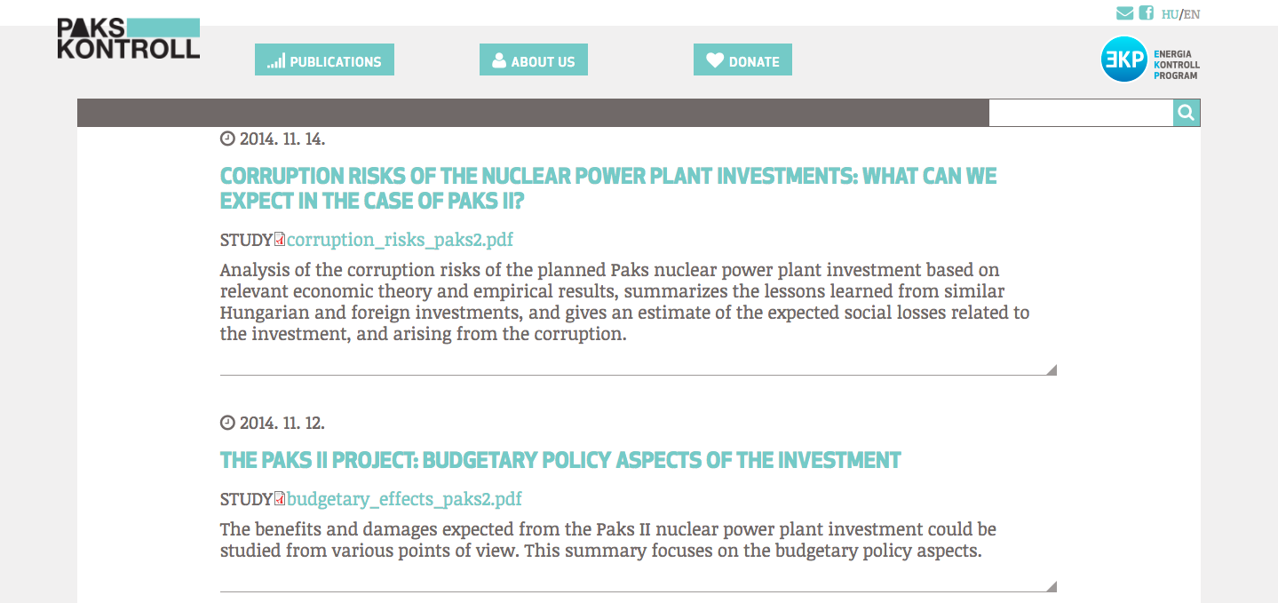
More information
See more on the http://www.pakskontroll.hu/en
…and on http://energiaklub.hu/en

Slide 16
Thank you for your attention!
Please contact me on fabok@energiaklub.hu

