Slide 1
Publicly funded nuclear lifetime extensions: story of Ukraine
Dana Mareková
St. Pölten, September 22, 2017
www.bankwatch.org

Slide 2
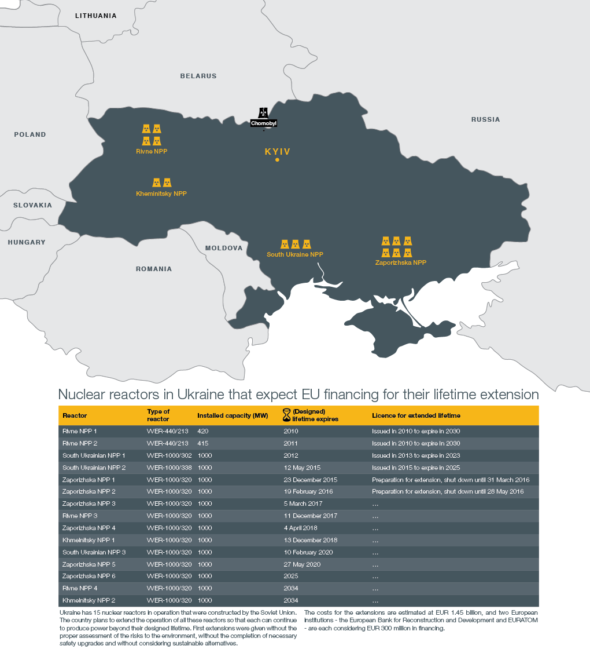
Story begins: LTEs in Ukraine
12 out of 15 nuclear units reaching the end of design lifetime by 2020
6 units got licenses extended for 10-20 years with no consulted EIAs
Euratom and EBRD approved loans over EUR 300 million each for 'safety upgrade’

Slide 3
Making powerful listen
GOOD GUYS? BAD GUYS?
Ukrainian government
EBRD, Euroatom/European Commission
Neighboring governments: Austria + Hungary, Slovakia, Slovenia, Romania
IMPORTANT ARGUMENTS – PLOT OF THE STORY
Conditions for European loans to Ukraine require
Adherance to Espoo and Aarhus conventions
Decommissioning system
www.bankwatch.org

Slide 4
Ukrainian government
…operation of nuclear units does not have negative impacts…and there are no parties according to the Espoo Convention…
…the analysis allows to conclude that practically no harmful transboundary impact is expected from normal operation of SouthUkraine nuclear power plant…
…notified the neighboring governments that the decision of the 6th Meeting of the Parties relates only to the extension of operation of units 1 and 2 of Rivne NPP and does not cover other operating NNPs of Ukraine…

Slide 5
European Commission
…compliance with Espoo and Aarhus conventions is a precondition for disbursing the loan…
…Concerning the international environmental agreements (including Espoo and Aarhus conventions), Energoatom and the Government of Ukraine shall undertake to comply with all environmental and social laws, including those relating to public consultation and/or participation…
…. Commission is of the opinion that any decision by Ukraine to extend the life-span of any of its nuclear power plants will require assessments under the conventions mentioned above (Espoo and Aarhus Conventions) whether or not it involves any physical work….
www.bankwatch.org

Slide 6
Neighbors – surprising twists
Repeated requests to UA government to apply Espoo
Letter to ECIC (sept 2016): calling for recommendations to UA to apply Espoo
In 2017 consultations started
Some governments are part of Espoo WG
www.bankwatch.org

Slide 7
Back to public funders – also surprising …
How is Ukraine meeting loan conditions?
Denial of request for access to documents
Court case
EU Ombudsman
www.bankwatch.org

Slide 8
Ukraine story today
EIA reports for Zaporizhia and SouthUkraine NPPs – poor quality
Start of voluntary transboundary consultations on ZNPP and SUNPP in May? 2017 – Austria, Slovakia, Hungary, Romania consulting public
Consultations not related to decision-making process for lifetime extensions
Promise to start negotiations with countries on Rivne 1, 2 – January 2018
www.bankwatch.org

Slide 9
Story is not only about Ukraine
92 reactors heading for LTE across Europe
Espoo and Aarhus undermined, but functional
We all have a legal and moral right and an “obligation” to have a say about our nuclear (free) future
www.bankwatch.org

Slide 10
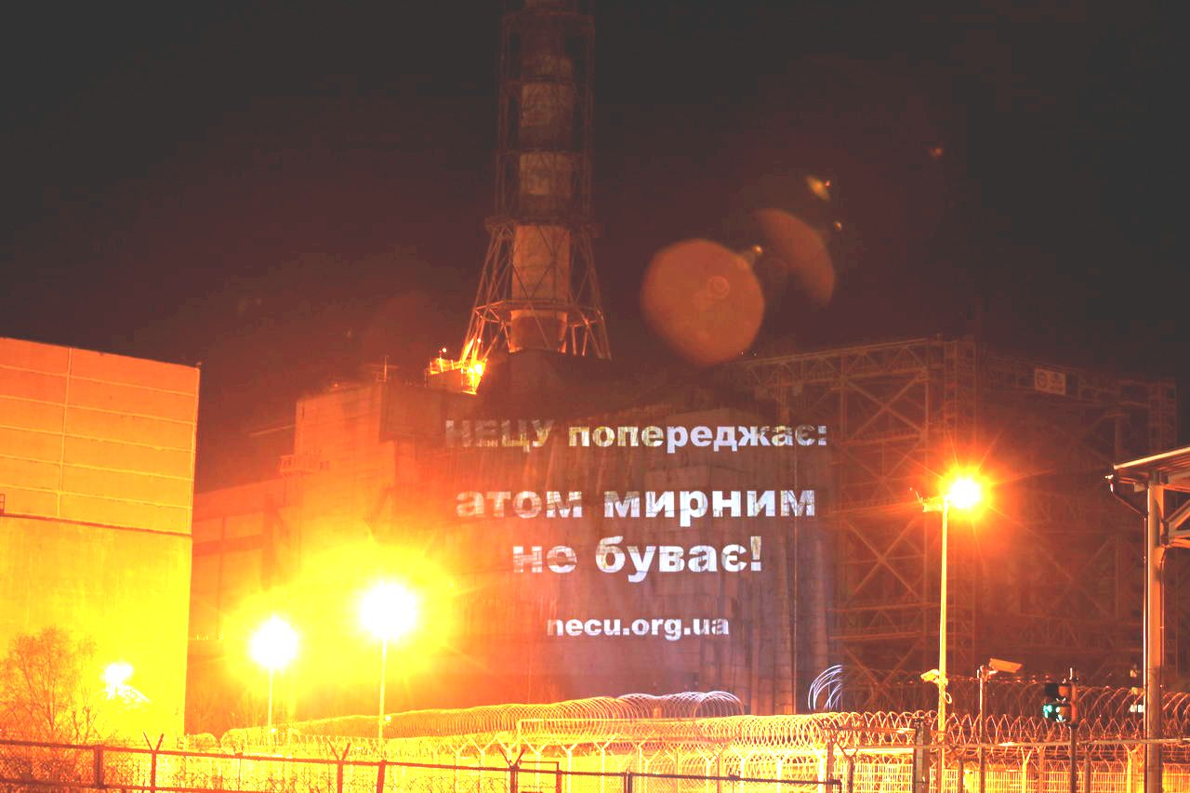
Thanks for your attention!
www.bankwatch.org

