Slide 1
2-nd Conference
COALITION “DANUBE REGION NUCLEAR FREE”
22-nd Sept 2017, St.Poelten, AUSTRIA
CONTROVERSY OF THE NEW NUCLEAR PROJECTS AT THE NPP KOZLODUY; INTERNATIONAL COOPERATION AND PUBLIC PARTICIPATION
Adi-Maria Simoiu
President of the Civic Association for Life

Slide 2
Work experience
Present work
University of Craiova, Faculty of Science, Romania
Physical Chemistry
Since 19.11.2014, voluntary work on nuclear matters, A.C.p.V
Past experience
R&D in chemical engineering
UN agency in the Hague, Netherlands, Nobel prize in 2013
OPCW inspector/over 60 state inspections worldwide
Mission planning coordinator,
Chemical industry, including R&D

Slide 3
Why we should be concerned about NPPs ?
Accidents
Human errors
Natural catastrophes
‘Volatile’ geopolitical situation
Terrorist attacks threat
Radioactive Waste
Unsolved problem
Danger of dumping in rivers and sea
Contamination of ecosystems

Slide 4
Nuclear Accidents
437 nuclear power plants are in operation around the world
Five major nuclear accidents have occurred in the past:
Kyshtym (Russia,1957),
Windscale Piles (UK, 1957),
Three Mile Island (USA, 1979),
Chernobyl (Ukraine, 1986),
Fukushima (Japan, 2011)
…hopefully the list will stop here !

Slide 5
Objectives of the presentation
Part I New Nuclear projects at NPP Kozloduy; Controversies
Part II International cooperation
Cross border context: Aarhus, ESPOO
Liabilities
Case study, international cooperation on NPP Kozloduy projects
Part III Public participation and actions referring to Kozloduy projects
Public debates, protests
Raising signatures and referendum request
Local administration and central environment authorities positions
Conclusions
References

Slide 6
PART I New Nuclear projects at NPP Kozloduy; Projects Controversies

Slide 7
The Kozloduy NPP, Bulgaria, located in the northwest part of the country in proximity to the town of Kozloduy.
It has 6 units, with Russian design pressurized water reactors (PWR), having a total electric power output of 3760 MW.
The construction and commissioning of the nuclear units was conducted in three stages:
Stage I: 1970 – 1975. Construction and commissioning of Units 1 and 2 with WWER-440 reactors, B-230 model.
Stage II: 1973 – 1982. Construction and commissioning of Units 3 and 4 with WWER-440 reactors, improved B-230 model.
Stage III: 1980 – 1991. Construction and commissioning of Units 5 and 6 with WWER-1000 reactors, B-320 model.

Slide 8
The units 1-4 at Kozloduy NPP ceased operation before the expiration of their design lifetime to fulfill commitments of Bulgaria related to the European Union accession. Units 1-4, in the course of decommissioning, have been transferred for management to the State Enterprise Radioactive Waste (SERAW).
Units 5 and 6, in commercial operation, are operated by Kozloduy NPP Plc., a company 100% owned by the Bulgarian state. Currently, Kozloduy NPP Plc. is a subsidiary of the Bulgarian Energy Holding Plc. Unit 5 reaches design lifetime in 2017 and Unit 6 in 2019.

Slide 9
Craiova ( aprox 300,000 citizens) is :
the historical capital of Oltenia province, South Romania
administrative center of Dolj County
( over 500 000 inhabitants).
Set within about 60 kilometers of NPP Kozloduy, Craiova is :
in the risk zone of Kozloduy nuclear site
together with another 23 villages and small cities in county Dolj
due to existing NPP and new controversal nuclear projects at Kozloduy.

Slide 10
NPP Kozloduy new projects
Construction of the 7-th unit of 1200MW
Atomnost, RF or
Westinghouse, USA
Lifetime extension of reactors 5 and 6 with 30 years
Nuclear waste repository - low and medium level ( 350,000 tones ) at Radiana (4 km from the Danube river), Kozloduy.

Slide 11
Projects controversies
Documentation of controversy of the NPP Kozloduy nuclear projects
1. Presentations of the projects during the official public debates in Romania ( 2011-201description of the projects presented on the Romanian Ministry of environment website.
2. Report of the Investment Proposal “Construction of a new unit of latest generation at NPP Kozloduy”, ordered by Federal Ministry of Agriculture, Forestry, Environment and Water Management, Austria
by A. Wallner, H. Hirsch, O. Becker, A.Y. Indradiningrat, M. Brettner
3. “A third NPP - in through the back door, Costs and benefits of the construction of unit 7 in NPP Kozlodui”
by Petko Kovachev, Bulgaria, Green Policy Institute

Slide 12
4. IAEA, web site Pre SAPTO report, peer review of the plant
5. Romanian expert report containing objections to the construction of the Nuclear waste repository, sent to the Ministry of Environment Romania on 10.05.2015,
6. Documents sent on 14.07.2014 from Romanian Minister of Environment, asking Bulgarian officials for full EIA report and requesting clarification and technical questions ref life time extension of the Units 5 and 6.
7. A.C.p.V. correspondence with Bulgarian representatives of the civic society ( 2016-2017).

Slide 13
Controversy of….
Lifetime extension of reactors 5 and 6
No public information and debate;
Decision (25.07.2014) of Bulgaria not to proceed with full EIA report;
Deliberately ignoring official request of Romanian Minister of Environment ( 14.07.2014) for EIA;
Proven accusation from Bulgarian civil society representatives of document manipulations by the Bulgarian officials to avoid Romanian request for EIA in crossborder context and technical & safety clarifications.

Slide 14
Peer review mission on safe long term operation (Pre-SALTO)
Was conducted at NPP plant Kozloduy, team: two IAEA staff members, five external experts and four observers.
A summary of the review, presented to plant management on 3.08. 2016.
The plant management indicated the intention to invite a “Pre-SALTO peer review mission” for Unit 6 in June or September 2018 to continue in the review of the plant preparation for LTO.

Slide 15
The team identified eleven issues in fundamental areas such as safety, ageing management of systems, structures and plant components :
“The plant documents providing requirements and guidance on Ageing Management (AM) and Long Term Operation (LTO) are not comprehensive;
The methodology for scoping and screening is not appropriately defined and documented and a part of the safety relevant structures and components is screened out of the LTO assessment without clearly documented criteria;
Plant programmes such as maintenance, in service inspection and surveillance are not adequately coordinated with ageing management and LTO; Scoping and screening for LTO, ageing management review (AMR) and ageing management programmes for mechanical structure, systems and components are not comprehensively implemented and reviewed.”
“Validity of environmental qualification of some equipment is not adequately controlled”.

Slide 16
Request for clarifications from Romanian Minister of environment ( 14.07.2014 ) not answered !
Scenarios for probabilities of nuclear incidents or accidents that may affect the territory of Romania and the Danube river,
Exposed areas and the forested measure to prevent, reduce and compensation for any significant adverse environmental effects;
Description of forecast methods used in the assessment of environmental effects;
The works proposal and estimated costs for the restoration of the site
when finishing activities, or in case of an accident.

Slide 17
The sources of polluants and emission, by type and quantity, expected for water, air, soil, subsoil, radiation, human settlements flora, fauna, climatic factors, etc., as well the waste expected to result from the project;
Description of the measures for the protection of the of environmental factors;
Consideration the potential transboundary impact, necessary to achieve a study of modeling polluants dispersion in the air in adverse conditions, with effect on Romania ( considering all meteorological factors ).

Slide 18
“The health impact study regarding the Romanian population in the area of influence should include:
a. The transboundary impact : estimation of individual and population excess risk for conditions associated to the exposure to ionizing radiation based on the estimated exposure levels covering, both normal operation instances, and all the possible scenario of incidents (worst case scenario);
b. The health impact study regarding the Romanian population residing in the area of influence of the Kozloduy NPP should take into account the facilities operating on the same site (waste disposal site, waste processing installation, new reactor, old reactors); thus, the estimation of the excess risk should take into account the cumulative effect of all these facilities working simultaneously and not individually !”

Slide 19
“The documentation does not include a strategy for the prevention of thermal and radioactive pollution risk in the context of climate change.
Climate change predictions : the south of Europe is expected the decrease of precipitation levels about 20% until the year 2050, which will attract a decrease of the Danube flow.”
“To mitigate the impact of climate change ( e.g. increased of the temperature, changing of the rainfall regime, increased of the frequency of droughts / floods), the International Commission for the Protection of the Danube River (ICPDR) has completed in the year 2013 a climate change adaptation Strategy for the Danube Basin (http:// www.icpdr.org ) which was not considered.”

Slide 20
“In the condition of decrease of the Danube flow, the thermal and radioactive impact is expected to grow by operation of the two units 5 and 6, requiring the long-term impact modeling to prevent negative effects
will be need to increase the volume of water used for the cooling, considering that the Danube flow will decrease.
Regarding the information on the transboundary impact, in Bulgarian notification is stated that no boundary impact is expected. This affirmation is not sustained by any documentation at least for severe probably accident; considering the most recent seismically data and the latest international requirements in the field.“

Slide 21
Romanian authorities were informed on occasions of audiences in 2016 and beginning of 2017 about proving documents, from Bulgaria, accusing Bulgarian authorities “of deliberately manipulated date 28.07.2014, as a submission date in MEW, to avoid considering Romania's request for EIA ( sent on 14.07.2015)”.
“The Supreme Administrative Court, SAC in its judgment in Case 11606/2014 never reported the letter from Romania although there was made a Bulgarian translation, so SAC did not paid attention to the intentional manipulation of date "Reference number MEW "- on 07.28.2014”.
New Romanian notification, was asked by the Bulgarian reprezenatives of Civic Society, for SAC case, requesting again EIA in crossborder context. Authorities refused, despite a draft of the notification, as initially agreed with the Minister, was prepared and sent to Romanian Minister by A.C.p.V ( Sept. 2016).

Slide 22
2. Nuclear waste repository controversy
There are objections from Bulgarian and Romanian experts to :
Location – on instable soil at only 4 KM from the Danube river only 30 m deep, above the surface waters;
Very large operating time (370 years) not sustained by construction materials;
Unjustified capacity of waste ( question not clearly answered at the public debates);
Geographical and geologic characteristics of the chosen site;
Contradictory info presented at the debate, on notification documents and illustration materials distributed to the Romanian public.

Slide 23
Totally inadequate, dishonest and manipulative compilation in terms of safety with the nuclear waste repository in Spain (El Cabril).
Information extracted from the impact assessment document sent to ACpV by Bulgarian experts, demonstrate that on site there will be buried nuclear waste containing radioactive material with a lifetime of millions of years ( the deposit is intended to ... resist only 375 years!).
The documents mention that "waste disposal is not allowed, if contains long-lasting nuclides (with a half-life longer than the half-life of Cs-137)"
"According to the EIA table, the" Radionuclide inventory “mention radionuclides (C-14, Nb-94, I-129) having half life much longer than Cs-137.
“The inclusion of radioactive waste in concrete cubes (2m side) does not allow effective control of the stored material”.

Slide 24
3. Construction of a new nuclear unit at NPP Kozloduy
Bulgarian Report
“Project financing, economic viability. This is one of the most non-transparent issues in relation to installing a new unit at NPP Kozlodui. Since the parameters that are being discussed are extremely inadequate and vague (e.g. “a price of under 100 BGN / MW”, “utilizing the infrastructure will decrease construction costs”, “the project will payback in 18 years' time”), the only way to make some kind of assessment of the risk is to compare the project with other nuclear projects currently in progress in Europe.
“NPP Belene is the most drastic example of concealing the true costs of a nuclear project.At the end of the day, its final forecast cost shot up from nearly 4 billion Euro to 10-12 billion Euro – that is 2.5 – 3 times!”

Slide 25
Austrian Report
“No detailed information on the safety systems of the reactor types under consideration, especially concerning passive core cooling system, passive containment cooling system.
The concept of practical elimination is not applied consistently in the safety requirements for the new unit. Practical elimination of accident sequences has to be demonstrated with state-of-the-art probabilistic and deterministic methods, fully taking into account the corresponding publications of WENRA.
Not provided information on assessments concerning the reliability and effectiveness of the safety systems of the reactor.”

Slide 26
“The seismic characteristics of the Kozloduy NPP site used as a basis for the environmental impact assessment were defined in the period 1991 – 1995
Not provided detailed information about the analyses conducted after 1995 to make sure that the seismic hazard assessment still fulfills the actual state-of-the-art in seismic hazard assessment for nuclear facilities (e.g. regarding model parameters, response spectra, consideration of uncertainties and assessment of local site effects).
No information about effectiveness and robustness of safety systems measures for prevention and mitigation of severe accidents in case of different design extension conditions (e.g. external events beyond the design basis).
No info about frequencies of scenarios with large early releases, efficiency of the retention of radioactive nuclides inside the plant with technical justification.”

Slide 27
“Different accident scenarios, consequences of a severe accident with a large release should be included in addition to the limited release scenario presented in the EIA-Report;
Incomplete information about the results of the dispersion calculation, only results for the distance of 200 km is presented; distance for transport of the radioactive substances after 48 hours, with wind velocities of 2 m/s or 5 m/s, is about 346 km or 864 km, respectively !
It shows that effects of severe accidents can be wide-spread and long-lasting and even countries not directly bordering Bulgaria, like Austria, can be affected !”

Slide 28
PART II INTERNATIONAL COOPERATION
- Npp Kozloduy case-

Slide 29
1. EIA in transborder context
ESPOO & Aarhus Conventions,
2. Obligations for early notifications
3. Liabilities
4. Preparness and response in case of nuclear accident
Medical support and specific infrastructure in case of nuclear accident
Best practices, lessons learned
5. Education
6. International cooperation, assistance and control
7. International cooperation –case study, nuclear projects at NPP Kozloduy in transborder context

Slide 30
1. EIA in transborder context
ESPOO Convention…
Notification of new nuclear projects
Transparency, public information
Debates in cross border context

Slide 31
Aarhus convention (Law 86/2000 in Romania)
The provisions of this Convention shall not affect the right of a Party to maintain or introduce measures providing for broader access to information, more extensive public participation in decision-making and wider access to justice in environmental matters than required by this Convention.
Each Party shall promote environmental education and environmental awareness among the public, especially on how
to obtain access to information, to participate in decision-making and
to obtain access to justice in environmental matters.

Slide 32
2. Obligations for early notifications
Governmental Decree 223/1990 for accession (of Romania) to the IAEA
Obligation for early notification of a nuclear accident
Assistance in the Case of Nuclear Accident or Radiological Emergency
Bilateral early notification agreements with: Bulgaria, Greece, Hungary, Russian Federation, Slovakia, Turkey,Ukraine.

Slide 33
3. LIABILITIES for nuclear accidents in the EU
Paris Convention of 1960, limiting the liability to operators in case of nuclear accidents to around EUR 700 million. In 2004 the compensation was increased to 1.5 billion Euro. This amendment has not yet come into force
The Vienna Convention 1963. In 1997 a Protocol amending the Convention was voted, increasing the compensation to 360 million Euro. The updated Vienna Convention entered into force in 2003. The Viena Convention is:
linked with the Paris Convention by a Common Protocol of 1988 (creating a joint regime with mutual recognition of the two Conventions), and is applicable in the majority of the ten new member states.
Obs. Neither the Paris Convention, nor the Vienna Convention address liability for environmental damages caused by a nuclear accident.

Slide 34
Liabilities…
The co-existence of two major third party nuclear liability regimes
with several subregimes, the 1963 Brussels Supplementary Convention (BSC), 2004 Paris Protoco, 1997 Vienna Protocol, 2004 Protocol to amend the Brussels Supplementary Convention
does not guarantee the same level of compensation for nuclear damage everywhere within the Community”.
Commissioner for Energy, Andris Piebalgs, Brussels, 3-rd October 2007.
Financial capacities are significantly lower for victims in member states party under the 1963 Vienna Convention.
Needs to implement the non-discrimination principle between victims outside and inside the installation state throughout the European Union.

Slide 35
Options of EU member states in terms of liabilities
Paris Convention only: Greece, Portugal
Paris Convention and BSC: Belgium, Denmark, Finland, France, Germany, Italy, the Netherlands, Spain, Sweden, the United Kingdom.
1988 Joint Protocol: Denmark, Finland, Germany, Greece, Italy, Netherlands, Sweden.
2004 Paris Protocol: Belgium, Denmark, Finland, France, Germany, Greece, Italy, the Netherlands, Portugal, Spain, Sweden and the United Kingdom have signed this instrument; none has yet ratified it.
1963 Vienna Convention: Bulgaria, Czech Republic, Estonia, Hungary, Latvia, Lithuania, Poland, Romania and the Slovak Republic.

Slide 36
1997 Vienna Protocol: Czech Republic, Hungary, Latvia, Lithuania, Poland and Romania have signed this instrument and only Latvia and Romania have ratified it.
1988 Joint Protocol: Bulgaria, Czech Republic, Estonia, Hungary, Latvia, Lithuania, Poland, Romania, Slovak Republic and Slovenia are party to this Protocol.
Paris Convention and BSC: Only Slovenia has acceded to these instruments.
2004 Paris Protocol and 2004 BSC Protocol: Only Slovenia has signed these instruments. Cyprus and Malta stand outside the legal frameworks created by these international conventions.

Slide 37
Examples of the application of liabilities conventions in different countries:
Germany: Nuclear damage liability is unlimited and every operator must secure coverage of the amount of 2.5 billion Euro; UK: the operator's liability should be increased from 160 million Euro per accident to 1.2 billion Euro per accident.
Finland: A 2005 Act requires operators to provide insurance of minimum 700 billion Euro, with unlimited liability. USA: Liability was introduced in 1957 and is currently over 10 billion US dollars. Russia: Liability amounts to 350 million US dollars.
Bulgaria: civil liability for nuclear damage is 96 million BGN (about 49 million Euro).
Civil Liability for Nuclear Damage, November 2009 http://www.world-nuclear.org

Slide 38
“In view of the consequences from the accidents in Three mile island, Chernobil, Fukushima, as well as presumed considerable participation of foreign companies in the construction and operation of the new capacity, the nuclear damage liability must be updated and increased significantly”.
P. Pechev, “A third NPP - in through the back door, costs and benefits of the construction of unit 7 in NPP, Kozlodui”, Green Policy Institute
“A harmonized liability scheme is needed,
including a mechanism to ensure the availability of funds in the event of damage caused by a nuclear accident without calling on public funds
Eurpean Economic and Social Committies (EECS)

Slide 39
4. International cooperation ON PREPARNESS AND RESEPONSE IN CASE OF NUCLEAR ACCIDENT
The preparation for emergency situations is a standard practice in the nuclear field and should be mandatory in EU.
Nuclear emergency situations response exercises should be performed by
the nuclear power plants operators
and regulatory bodies, involving the responsible local and national authorities,
in order to
continuously improve the emergency response,
correctly inform the public,
ensure all safety measures in the event of a nuclear emergency.

Slide 40
Assuring medical support and specific infrastructure ( shelters, protective equipment ) in case of nuclear accident;
Actions for prevention and intervention in case nuclear accidents and radiological emergency, based on lessons learned from previous accidents;
Establish emergency evacuation plan, establish routes of escape, assure KI pills for possible affected population, non contaminated food & water supplies;
Develop a preventive measure evacuation plan of the population and assure the necessary evacuation infrastructure.

Slide 41
5. INTERNATIONAL COOPERATION ON EDUCATION
In majority, world wide, present school text books - emphasis on advantages of nuclear energy, considered as :
‘Green energy’ and ‘clean’ ( forget about mining industry, the unsolved radioactive waste generated ),
Cheap energy – in fact not cheap a all, it is government subsidized !
Safest source of energy,
Ignoring alternative sources of energy,
Eliminate the myth of …generating and employing highly qualified work forces, well paid in NPP’s ( but not mentioning about expensive medical costs to treat …’untreatable’ diseases, developed in the ‘business’.

Slide 42
6. INTERNATIONAL COOPERATION - KOZLODUY CASE- or an example of what it should not be done
…example of … ‘official’ …’International cooperation’:
“ We have Cernavoda, then we should not touch Kozloduy !”
J.Marinescu, EU (Romanian) parliamentary, Craiova, Public debate on new nuclear projects at NPP Kozloduy, 12 July 2015
Members of Craiova Local Council, Debate on Referendum request, Craiova City hall, 24 Sept. 2015.

Slide 43
GENERAL INSPECTORATE FOR EMERGENCY SITUATIONS – GIES- BUCHAREST ANSWER TO A.C.p.V. REQUEST FOR SPECIALIZED INFO, 24/11/2016
“… At the Nuclear plant from Kosloduy, the type of reactor is not similar to the one from Cernobal, but it is enveloped.
Regarding the new location from Belene, the problem is still opened to discussion in CAT ( Romanian Defence Council ) concerning the agreement on the location of the NPP Belene; Romania has not given the approval, yet !”

Slide 44
GIES report ref international cooperation…
“Managing a large number of people possibly contaminated is hard to appreciate, and
In all of this type of events as major nuclear accidents, international assistance has to be requested !”
Acquisition of a number of vehicles for research CBRN
Mobile units for mass decontamination on open platform track.
Each mobile decontamination unit has a capacity of 80 person/hour.
“Given the existence of other similar units nationwide, Romania is ready to achieve decontamination of large numbers of people possibly contaminated.” ???

Slide 45
Report from inspectorate for emergency situations, county Dolj contradicts the report form GIES, Bucharest
Shelters in Dolj County - over 550 000 people -
A number of 241 civil protection shelters,
These spaces provide housing to 15% of necessary capacity, Dolj county.
In addition, identified other private areas (basements, cellars) with a total capacity of 43,706 people, representing 32% of necessary shelters.
Craiova ( academic center with international students ) shelters :
A number of 203 shelters for civil protection representing 19.7% of municipality necessity.
Identified other 214 privately own spaces (basements, cellars) with a capacity of 25.010 people, representing 16% of its sheltered.
In total, Craiova (300,000 people) has percentage of 35.7% of necessity.

Slide 46
Notification received from the Bulgarian authorities are missing important info:
Theory : According to European Atomic Energy Community Treaty, Directive 2013/59, Bulgarian authorities are required to notify international institutions and neighboring countries possible affected in the event of a radiological emergency or nuclear accident.
In practice : so far, the Bulgarian authorities did not communicate to the Inspectorate for Emeregency Situations from Dolj county, at least, the requested information needed for :
developing and implementing a worst case scenario !

Slide 47
Emergency planning zones in context of international cooperation
Theory : Needed to apply measures to protect the population in case of a nuclear accident.
Reality :
Long Term Planning Zone (LPS) was not communicated to Romanian specialized authority (National Commission for Nuclear Activities Control) by the Bulgarian authorities;
IES Dolj complained, but no further actions taken from central specialized Romanian authorities !

Slide 48
Main Medical Infrastructure in Craiova, serving emergencies for population in county Dolj, and possible affected people in a nuclear accident in Bulgaria ( Kozloduy located aprox. 60 km from Craiova).
Emergency County Hospital Craiova
Railways Hospital
Hospital Filantropia
Military Emergency Hospital

Slide 49
Railways Hospital, Craiova
Report of the hospital manager from 19.06 2015
“We have no specific means of treatment, radioactive decontamination of victims in case of a nuclear disaster;
Capacity of first aid and treatment of patients is insufficient due to low number of available medical specialties for which we can provide hospitalization.
The health facility is unable to provide specific protection and treatment, even to its own medical staff in case of nuclear accident.”

Slide 50
Emergency County Hospital, Craiova
the largest health facility in Oltenia and county Dolj,
shows in the Report no 90639/19.06.2015 that the facility
"does not have a space of adequate shelter, for the protection of civilian population to a situation of
massive earth crake, fire,
biological or
nuclear accident,“
According to the report there is available a plan for defense in case of fire, and general emergency situations, but not specific for nuclear accident.

Slide 51
Official debates and international cooperation
A. Nuclear waste repository
State-run Enterprise "Radioactive Waste" (DP RAO) held a public discussion - 07.07.2011, Becket, Romania - of the project “National storage for low and intermediate level radioactive waste (NSRW)”.
The discussion was organized and conducted due to the requirements and procedures of the ESPOO Convention in a transboundary context.
Bulgarian authorities assured that the project does not pose … a threat to the citizens of southern Romania. The only problem could occur in the event of an accident, which will affect, 23 settlements.

Slide 52
Bulgarian authorities were accused by Romanian and Bulgarian NGO’s of vague information, manipulation and intimidation of the public and lack of transparency.
Civil society from Bulgaria took legal action against Bulgarian environmental authorities and won the case at the Bulgarian Administrative Supreme Court.
Consequence: new public debate in Bulgaria and Romania on the topic became mandatory!

Slide 53
New ‘public‘ debate in cross-border context took place in Craiova at the Concert hall on 09.07.2016
The participants, only about 15 Romanians, and 3 representatives from the civil society from Bulgaria noticed a flagrant violation of ESPO and Aarhus Conventions:
No proper announcement, except few emails sent by the local environment agency to ‘selected’ institutions, with a vague info about the debate, no info about the purpose, reason , participants, etc.
The date and time was specially chosen, with a big mall opening in the centrum of Craiova, with free food and drinks, half an hour before and just few meters away from the debate location.

Slide 54
Participants at the official debate in Craiova, Romania
Romanian public mostly A.C.p.V. representatives and volunteers aprox 15/300 000 citizens from Craiova ( academic center).
Romanian officials : 4
Bulgarians officials : 5
Representatives from Bulgarian civic society :3
Silent but ‘helping’ environmental agents to increase the participants number: about 10.

Slide 55
A visible professional announcement about the public debate was only on the day of the debate and displayed at the front door of the concert hall only, with 4 min before the meeting, half an hour after the majority of the citizens, already went to the opening mall scheduled with months in advance in the same day.
Both Romanian and Bulgarian representatives of the civic society took proving pictures !
At the city hall was no public announcement either !

Slide 56
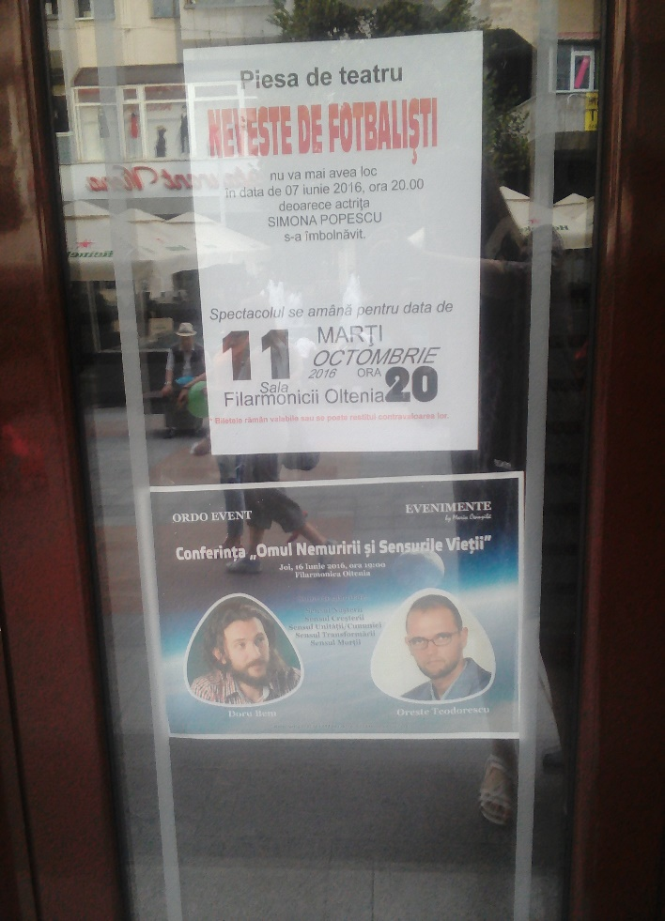
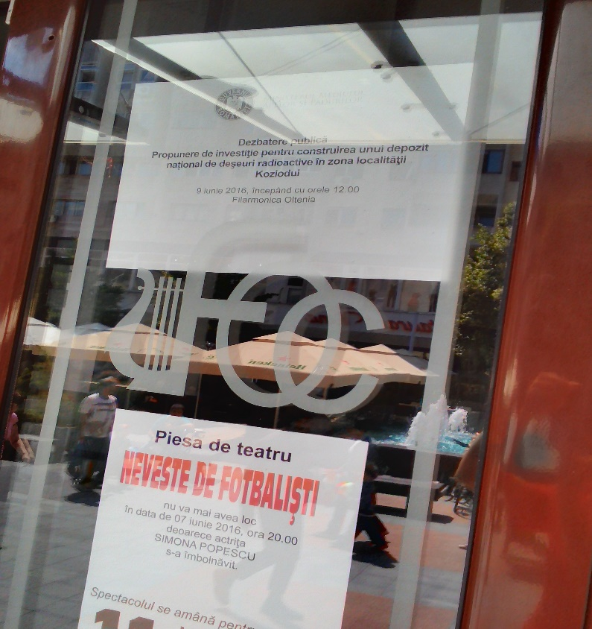
How it was announced the …public debate on 09/07/2016 or … from… ‘nothing’ to very professional info in a time interval : 11:25 to 11:56 ( debate started at 12:00)
11:20
11:25
11:56

Slide 57
When, difficult to answer, questions ( such as repository waste capacity, source and type of the nuclear waste, location not justified, technology, etc) were asked by civic society representatives from Romania and Bulgaria, the translator refused to do the translation, motivating that they (Bulgarian non-official ) were “not invited”.
Again no reaction from the Romanian authorities present at the meeting !
It was an attempt to discourage public participation, in fact !
Both, Romanian and Bulgarian representatives from the civil society observed:
Aarhus Convention provisions were flagrantly violated !
ESPOO Convention was, in fact, just …simulated !

Slide 58
B. Official public debate on the construction of the 7-th unit at NPP Kozloduy, under ESPOO convention
Locations : the City Hall Craiova 19.11.2014 and Bucharest 20.11.2014, at a private university;
Participants:
Romanian public 6 /260 000 respectively, 7/1 500 000
Romanian officials : 4
Bulgarians officials : 34
Bulgarian civic society :2
‘Silent’ to remain :‘Helpful’, environmental agents ( Craiova ) and local administration staff aprox 20 ( Craiova).

Slide 59
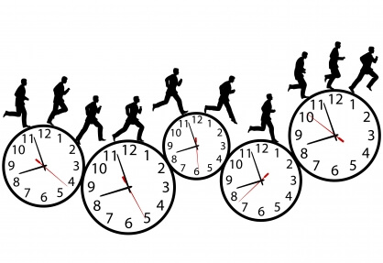
Use of manipulative statistic approach, marketing approach , mentioning, not clear pictures about type of reactor, safety features, contractor ( USA or Russian Federation) ‘the probability’ of an incident or accident is from small to …unlikely, deliberately eliminating an important detail, it can be …
ANY
TIME !

Slide 60
the catastrophic impact of a nuclear accident is not mentioned at all in terms of causalities, possibilities to treat victims, locally or crossborder, and other EP&R related topics …
Radioactivity measurements results presented to the population, if presented, without a scientific approach:
Precision of the determination, place, date and time, to be verified
Present only good …’friendly’ data, despite incidents were …signaled by the media !

Slide 61
C. Life time extention of reactors 5 & 6
No public debate !
Letter from former Romanian Minister of environment, A. Korodi, sent to Bulgaria on 14.07.2014 was ignored, stamped at the Ministry of environment in Bulgaria on 28.07.2014, three days after Bulgarian decision was taken, on 25.07.2014, not to proceed with full EIA in cross border context.
Critical questions and explanation requests from the minister about technical details of the project were never answered, or clarified by Bulgarian authorities.

Slide 62
5. International cooperation assistance and control …
A.C.p.V. considers important to :
introduce the concept of Europe as one ‘country‘ in terms of safety of the population and environment; equal treatment & right to healthy, decent life for all people;
Harmonize and further implementation at national levels, international rules and regulations on nuclear matters,
International control of national available founds, infrastructure and medical equipment needed in case of a catastrophic nuclear event; developing and updating plans for the worse case scenarios, considering climate change and new geopolitical threats.

Slide 63
4. Establish an international tribunal for crime against the environment, with a special emphasis on nuclear matters, to protect/defend people right and associated ecosystems for a healthy life in a safe environment;
5. Create a Central EU bank for environment protection, the biggest polluters and risk posing to the health of the people and environment within EU should be obliged to contribute more, see example of the UN agency, OPCW;
The founds should be invested in alternative energy sources, education and research on this matter, medical and emergency infrastructure!

Slide 64
PART III PUBLIC PARTICIPATION AND CIVIC SOCIETY ACTIONS REFERRING TO THE NEW PROJECTS AT THE NPP KOZLODUY

Slide 65
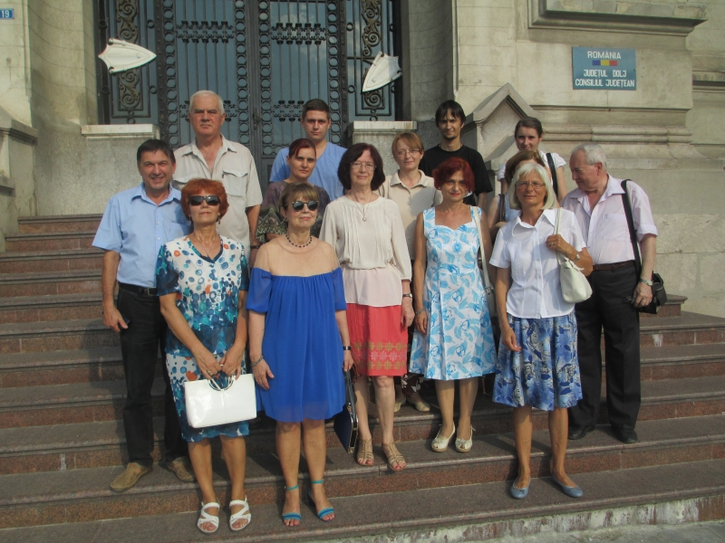
Initial Civic Action Group – created in January 2015- became Asociatia Civica pentru Viata (A.C.p.V.) - Civic Alliance for Life-
Members : academic staff, school
teachers, artists, medical doctors,
students, engineers, retired people, etc.

Slide 66
How ALL STARTED ?

Slide 67
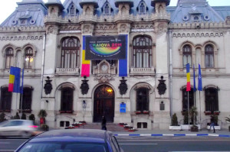
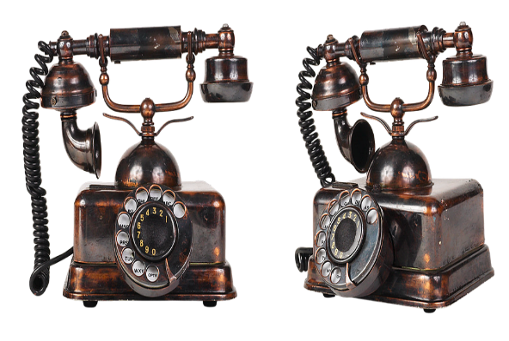
Announcement from Chemistry dept. Univ. of Craiova to participate at a public debate of a project: a new reactor, 7-th unit at the NPP, Kozloduy, Bulgaria
19 November 2015, 12:00 City hall, Craiova

Slide 68
Public information provided by the Civic Action Group ( later transformed in Civic association for life, A.C.p.V. Craiova
At the University of Craiova on 31.01.2015, on “Construction of the unit 7-th”
Participants : about 300 Romanians (and 6 representatives from Bulgaria)
Voted for requesting local administration to organize a referendum referring new nuclear projects:
A.C.p.V. organized a public information on the nuclear waste repository topic on 7.05.2015, about 200 participants, at University of Craiova.
Based on the scientific consultations with Romanian specialists, objections to the project were formulated and sent the Romanian Ministry of Environment on 10.05.2015. No relevant answer !

Slide 69
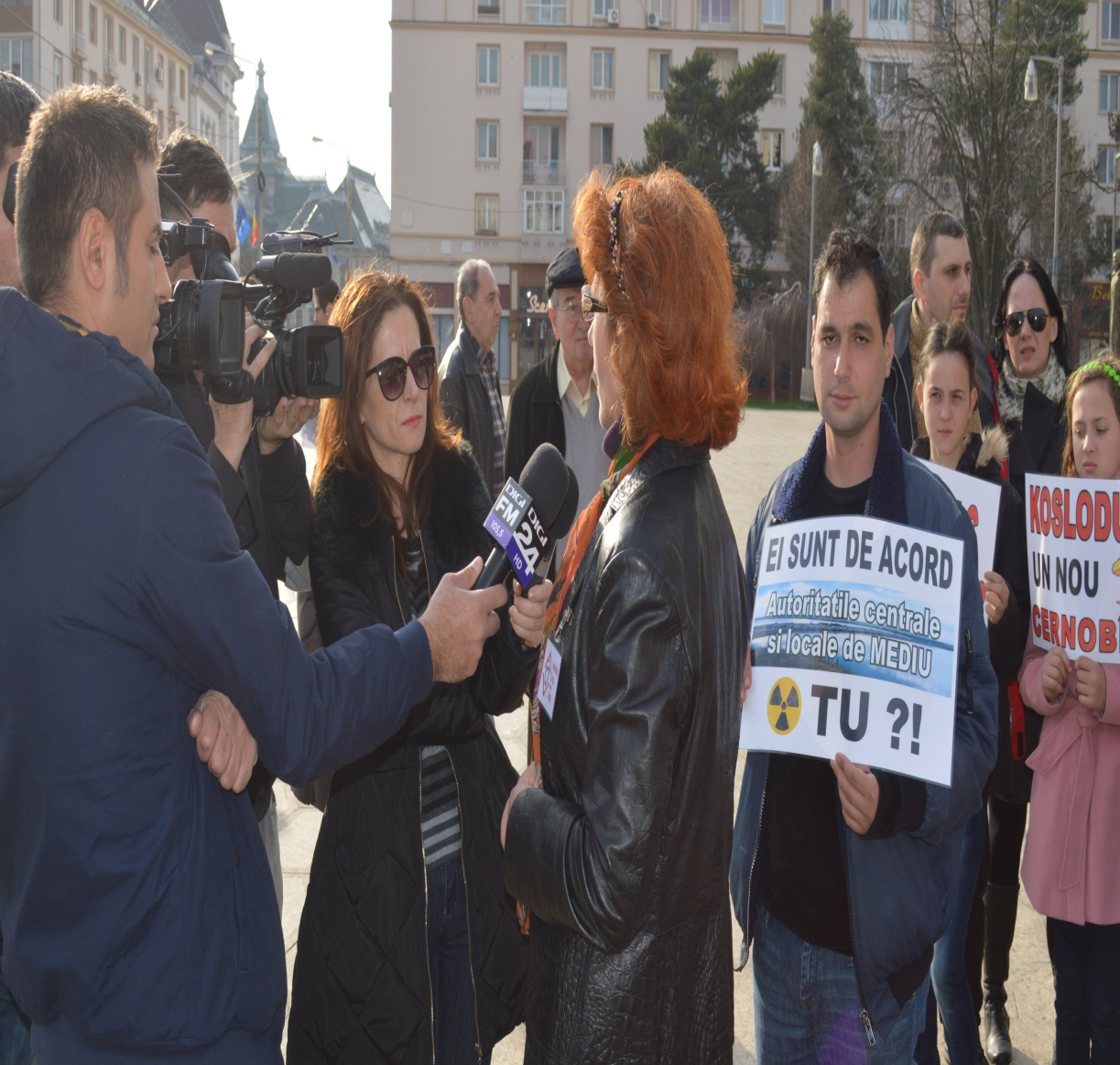
Participated at over 20 debated in Bucharest and Craiova at municipal library, University of Craiova, TV and radio invitations.
Organizing public debates, 2016-2017.
Organizing authorized meeting and protest, 2015, and 2016.
Interviews, national and international ( Bulgaria and Austria ).

Slide 70
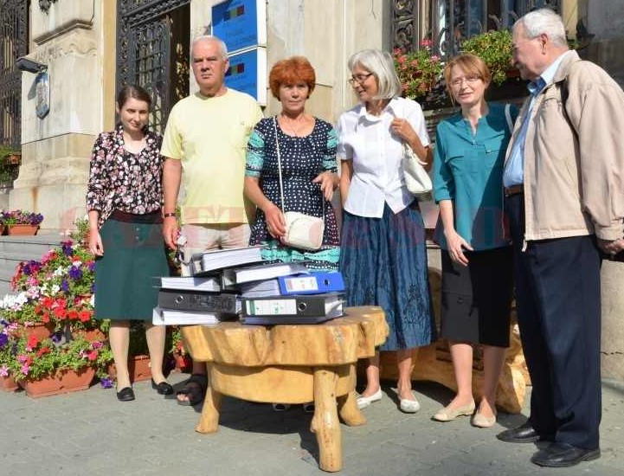
Referendum request sent on 19.09.2015 to the city hall Craiova
in accordance with the local administrative law, over 15,300 signatures (13,000 needed) were collected from Craiova voting citizens (6 months period.)
requesting to be consulted on the NPP Kozloduy projects by a local referendum

Slide 71
Public Local Council meeting for referendum request, Craiova City hall, 24 Sept. 2015
Over 100 citizens of Craiova came to participate at the meeting
many were not allowed in the meeting hall.
by Romanian law, Local Council meetings are public !
Legal support for requesting the referendum, on the draft project proposed by A.C.p.V., included Aarhus convention, ratified by Romanian in 2000.
On the final version of the project, the paragraph containing Aarhus reference was taken out.
Shortly, it was a flagrant brake of the citizens rights !
http://www.romaniacurata.ro/bravo-craiova-civica-petitie-cu-numar-record-de-semnaturi-pentru-declansarea-unui-referendum-local-cine-sunt-cei-care-demonstreaza-ca-cetateanul-roman-nu-este-o-masa-amorfa

Slide 72
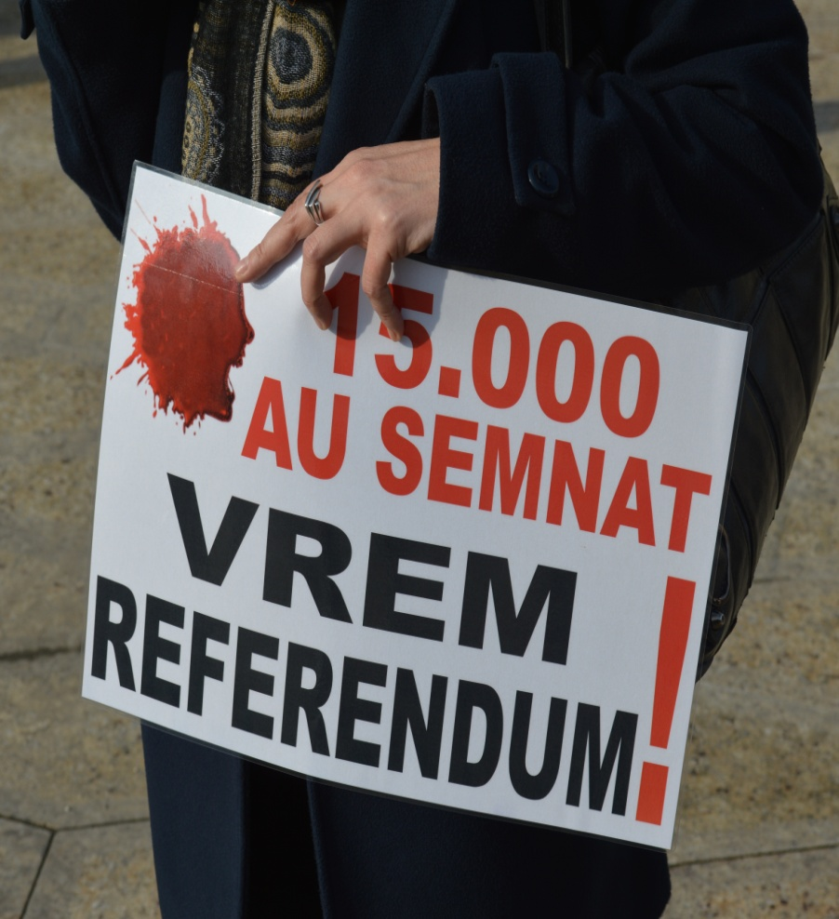
Referendum request…REJECTED
The reasons invoked at the LC meeting to reject the referendum (8 votes against, 15 abstained and 2 in favor ) on 24.9.2015 were irrelevant and have no connection with the topic, such as:
Initiative of asking for referendum…illegal because represents … ”the Netherlands interest “ !
nuclear energy is green ,
in Romania “we have a NPP at Cernavoda, so we should not touch Kozloduy”,

Slide 73
Further referendum requests
New referendum requests were submitted at the city hall in December 2015, March 2016 and Sept 2016 and the civic project was not taken into consideration.
The new requests were in favor of simultaneously organizing the referendum with local or parliamentary Romanian elections.
No explanation of refusal was offered by local administration.

Slide 74
International activity A.C.p.V. Craiova
Member of “Danube region nuclear free” coalition, HQ Vienna
Participation at the Nuclear Energy Conference, NEC, Prague on 05.04.2016
Toghether with DRNF Coalition, initiate the draft resolution at the end of NEC, referring to new rules to be applied by countries
developing new nuclear projects, or
life time extension of old reactors.
Participation at the EP&R regional meeting, Sofia, Febr. 2015,
Participate at “Aarhus Convention & Nuclear Roundtable, Nuclear Emergency Preparedness and Response”, on 29-30 November 2016, Luxembourg

Slide 75
Did we addressed and asked assistance & info from Romanian authorities ? YES !
Local administration
Local and central environmental authorities
Central Romanian Authorities
Prim Minister, 2016
Ministry of environment, sent relevant documentation, letters and request for audiences in 2016, 2017;
Ministry of Foreign Affaires ( 17.11.2016), due to the fact …Ministry of Environment considered that they did all necessary to respect all conventions on the nuclear field and Bulgarian officials did not take them into consideration !
Ministry of Foreign Affairs : answer ( 06.01.2017) they will initiate a bilateral expert consultation, no action so far !

Slide 76
CONCLUSIONS
Part I Tree New Nuclear projects at NPP Kozloduy; Controversies;
Part II International cooperation
Cross border context: Aarhus, ESPOO
Liabilities, need to harmonize
Case study, international cooperation on NPP Kozloduy projects case in cross-border context; from …papers fulfillment of international convention to a different… reality
Part III Public and civic actions referring to Kozloduy NPP new projects
Public debates, protests, raising signatures and referendum request –rejected-
Local administration and Bulgarian & Romanian central authorities positions :

Slide 77
And what we would like to recommend more…
New nuclear projects or/and life time extension of old reactors should be accepted, only, if the nuclear ‘nostalgic’ countries will provide:
Evidence of having possibilities to treat adequately and provide shelters all the population affected,
Evidence of financial capability to deal with decontamination and safety in case of nuclear accident,
Guarantee that no terrorist attacks or aircraft crash will take place on theirs nuclear perimeters,
As per Aarhus convention, people should be consulted if they want new NPPs or not !

Slide 78
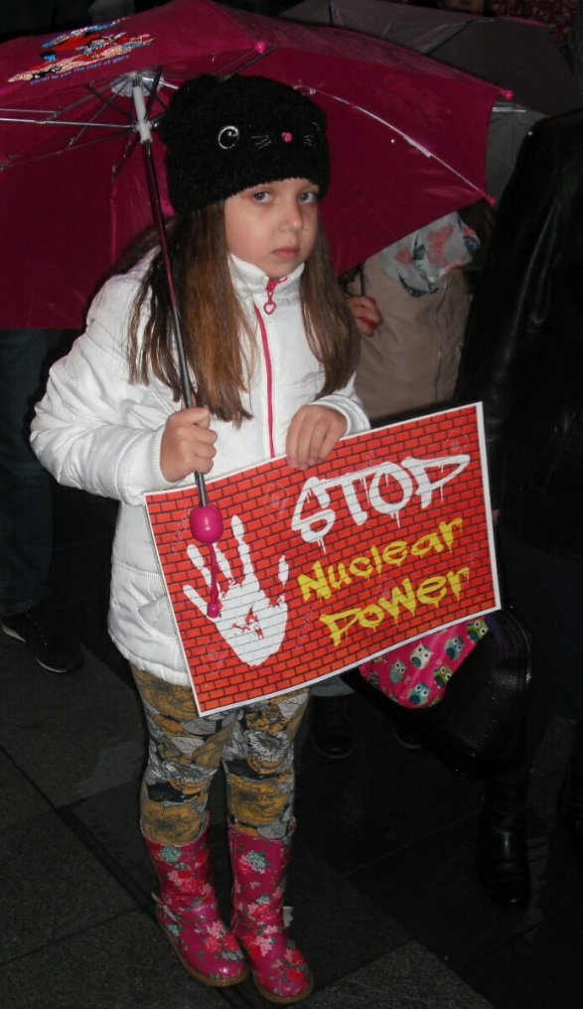
We did our part ! What is next ?
“S.O.S ! “
EU institutions,
International assistance and cooperation on nuclear matters,
And that in the name of future generations not only on both sides of the Danube river, but world wide !
Danube should remain ‘blue’ not …purple !

Slide 79
References
http://www.romaniacurata.ro/bravo-craiova-civica-petitie-cu-numar-record-de-semnaturi-pentru-declansarea-unui-referendum-local-cine-sunt-cei-care-demonstreaza-ca-cetateanul-roman-nu-este-o-masa-amorfa/
http://www.gds.ro/tag/kozlodui/
http://www.gds.ro/Local/2015-01-30/construirea-un-nou-reactor-nuclear-la-kozlodui,-dezbatere-la-universitatea-din-craiova/
http://www.gds.ro/Local/2015-06-04/kozlodui,-bomba-care-poate-arunca-aer-alegerile-locale-din-craiova/
http://www.gds.ro/tag/kozlodui/
http://www.gds.ro/Local/2015-01-30/construirea-un-nou-reactor-nuclear-la-kozlodui,-dezbatere-la-universitatea-din-craiova/
http://www.gds.ro/Local/2015-06-04/kozlodui,-bomba-care-poate-arunca-aer-alegerile-locale-din-craiova/

Slide 80
http://www.jurnalulolteniei.ro/vizualizare/dezbatere-publica-despre-riscurile-radioactive-de-la-kozlodui-120398
http://www.vocea-olteniei.ro/index.php/comunicate/item/5192-dezbatere-public%C4%83-pe-tema-depozitului-de-de%C5%9Feuri-nucleare-de-la-radiana-kozlodui
http://www.lupamea.ro/articol.php?id=27328
http://www.curierulnational.ro/Actualitate/2015-06-05/Kozlodui,+bomba+care+face+valuri+in+Oltenia+
http://www.imaginearomaniei.ro/index.php/comunicate/item/5456-dezbatere-public%C4%83-pe-tema-depozitului-de-de%C5%9Feuri-nucleare-de-la-radiana-kozlodui
http://www.craiovaforum.ro/stiri/cultura-2/este-energia-nucleara-o-energie-curata-si-sigura-pentru-mediu-dezbaterea-gazduita-de-biblioteca-judeteana.html
http://www.romaniacurata.ro/premiera-se-pregateste-un-referendum-antinuclear-la-craiova-mai-lipsesc-doar-3-000-de-semnaturi/

Slide 81
http://www.digi24.ro/Stiri/Digi24/Extern/Europa/Bulgarii+vor+sa+construiasca+un+nou+reactor+nuclear+la+Kozlodui
http://www.digi24.ro/Media/Emisiuni/Regional/Digi24+Craiova/Vocile+Olteniei/11+05+2015+Depozit+de+deseuri+radioactive+la+granita+Romaniei
http://www.digi24.ro/Stiri/Regional/Digi24+Craiova/Stiri/Vor+referendum+pe+tema+Kozlodui+Mai+multe+ONG-uri+au+strans+deja
http://www.digi24.ro/Stiri/Digi24/Extern/Europa/Bulgarii+vor+sa+construiasca+un+nou+reactor+nuclear+la+Kozlodui
http://alege.tv/emisiuni/audienta-generala/2015/07/09/audienta-generala-52/
http://alege.tv/emisiuni/audienta-generala/2015/08/31/audienta-generala-57/
http://alege.tv/emisiuni/audienta-generala/2015/09/24/audienta-generala-63/
https://www.youtube.com/watch?v=AafVyjK-qzs

Slide 82
actualno.com/prof-simou-za-actualnocom-v-rumynija-iskame-da-sprem-sedmi-blok-na-kozloduj--news_456788.html
http://www.ziarelive.ro/stiri/pericol-nuclear-in-spitalele-craiovei.html
http://www.gds.ro/Local/2015-07-11/pericolul-nuclear-de-la-kozlodui,-dezbatere-publica-la-craiova/
http://www.hotnews.ro/stiri-mediu-20123570-proteste-craiova-fata-construirea-unui-depozit-deseuri-radioactive-kozlodui.htm
http://www.hotnews.ro/stiri-mediu-20123570-proteste-craiova-fata-construirea-unui-depozit-deseuri-radioactive-kozlodui.htm
http://www.romaniacurata.ro/bravo-craiova-civica-petitie-cu-numar-record-de-semnaturi-pentru-declansarea-unui-referendum-local-cine-sunt-cei-care-demonstreaza-ca-cetateanul-roman-nu-este-o-masa-amorfa/
http://wwwns.iaea.org/actionplan/missions.asp?mt=SALTO&my=All&cn=All+countries&ms=Completed&func=search&submit.x=9&submit.y=13
http://wwwns.iaea.org/downloads/actionplan/26_Kozloduy%20SALTO%20executive%20summary.pdf

Slide 83
THANK YOU FOR YOUR ATTENTION !

